Slide 1


NINIO QUEROL
MINI PROJECT 1
PET COURIER AND TRANSPORT SERVICES

Slide 2
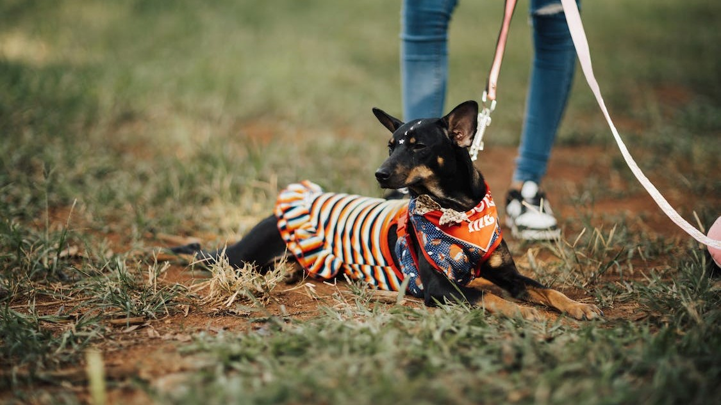
PROBLEM
HAVING PET IS ONE OF THE HAPPIEST MOMENT OF OUR LIFE, BUT HAVING A PET COMES WITH A RESPONSIBILITY.
SOME OF OUR PWT OWNERS FOUND AN OPPORTUNITY ON SELLING OR REHOMING THE OFFSPRING OF THEIR BELOVED PETS. WHAT IF YOU HAVE A DEAL WITH OTHER PET LOVERS BUT YOU CAN’T GO TO THEM BECAUSE THEY ARE TOO FAR?

Slide 3
SOLUTION
WITH OUR WEBSITE, WE HELP ASPIRING PET LOVERS TO HAVE THEIR DREAM PET MOVE TO THEM WITH EASE AND SECURITY.
WE PROVIDE TRANSPORT SERVICES WITH OUR TRUSTED PARTNER WHO ARE SPECIAIZING IN HANDLING PET WITH CARE AND LOVE.

Slide 4

INTRODUCTION
“Our team cares for your
pet as much as you do.”
Our fabulous team has been carefully selected to ensure
that you and your pet encounter the highest level of care
at every stage of your experience with Pet Express.
With many long serving and knowledgeable team members,
we are the pet travel experts who love what we do!

Slide 5

TARGET USER
PET BREEDERS
PET LOVERS
ASPIRING PET LOVERS

Slide 6
HOME
CONTACT
REQUEST QUOTE
SERVICES
ABOUT US
YOUR DETAILS
OUR TEAM
PARTNERS
PET TRANSPORT
ADOPT PET
PET DETAILS
YOUR DETAILS
TRAVEL DETAILS
SUBMIT DETAILS
SUBMIT DETAILS
SITE MAP

Slide 7
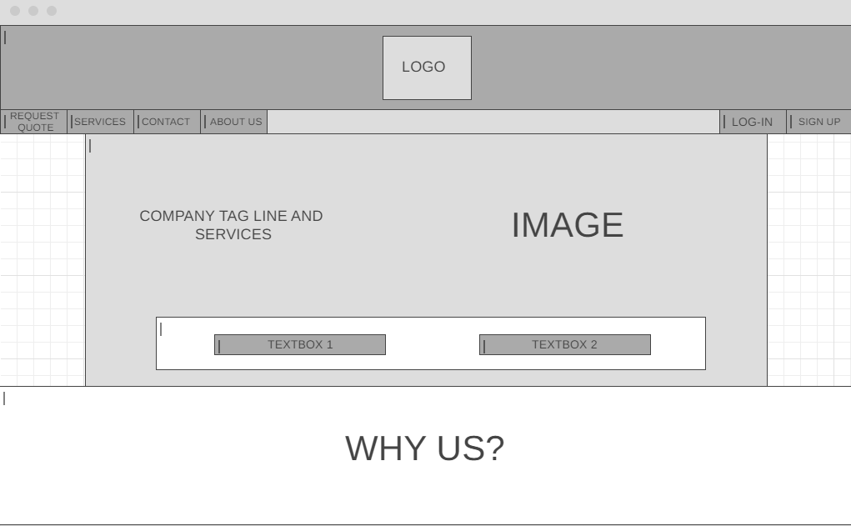

WIREFRAME

Slide 8
THANK YOU

